Slide 1
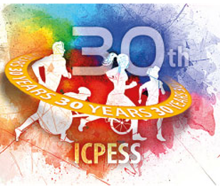
COMMON VIRAL CUTANEOUS INFECTIONS IN SWIMMERS Sfyri, E., Tertipi, N., Kefala, V., Papageorgiou, E., Rallis, E. University of West Attica, Department of Biomedical Sciences, Athens, Greece
Introduction
Swimmers are less likely to suffer from injuries caused by contact with opponents, surfaces, or equipment. However, the special environment of a swimming pool, creates its own special group of skin conditions that are either unique to the sport or shared with other sports (Basley et al., 2000). Molluscum contagiosum (MC) and warts are common viral infections of the skin. Attendance at swimming pools has been found to be a signiﬁcant risk factor for both infections in children (Kakourou et al.,2005; Van Haalen et al., 2009). Incorrect behaviors are rife among swimming pool users and there is little awareness of the importance of pool rules for restricting health risks (Pasquarella et al., 2014). Data regarding the prevalence of MC and verruca in competitive swimmers are lacking in literature.
Methods
The study was approved by the Ethic Committee of the University of West Attica and the Hellenic Swimming Federation. Due to COVID-19 pandemic restriction measures, an online survey was conducted, from March to May 2021. Ten swimming clubs from Attica Region and province cities were participate. Swimmers’ parents (9-12 years old and 13+ years old) and adult swimmers were asked to complete an anonymous questionnaire. Participation was not mandatory. The data analysis was estimated with statistical package IBM SPSS 26.0.

Slide 2
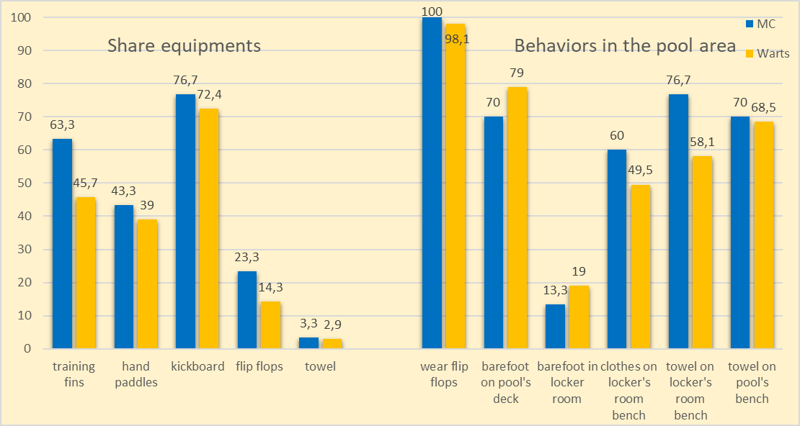
Results
244 swimmers enrolled in this study (response rate: 24.3%). 12,3% (n:30) reported MC and 43% (n:105) warts, during their swimming career, diagnosed and treated by dermatologists. There was no different between sexes for MC but diagnoses of warts were higher in females (46,3%). Most of the responders with MC were in the 13-14 age categories (n:11, 19.3%). Elder groups were more likely to be infected with warts. The incidence of MC and warts in swimmers who use outdoor facility was higher. History of seasonal allergies had an increased risk of having MC (OR = 3.026 CI 95% 1.379–6.640, p = 0.004). A family history of warts (OR = 2.107 CI 95% 1.557–2.852 p = 0.012) and atopy (OR = 2.729 CI 95%1.111–6.706 p = 0.024) had an increased risk of warts infection. Axillary and trunk were the most common sites of primary infection for MC (73.3%, p=0.016) but warts mainly appeared on the soles (45,7%).
References
Basley, R.S., Basley, G.C., Palmer, A.H., Garcia, M.A.(2000). Special skin symptoms seen in swimmers. J Am Acad Dermatol,43:299-305.
Kakourou, T., Zachariades, A., Anastasiou, T., Architectonidou, E., Georgala, S., Theodoridou, M. (2005). Molluscum contagiosum in Greek children: a case series. Int J Dermatol,44:221-3.
Van Haalen, F.M., Bruggink, S.C., Gussekloo, J., Assendelft, W.J., Eekhof, J.A. (2009). Warts in primary school children: prevalence and relation with environmental factors. Br J Dermatol,161:148-152.
Pasquarella, C., Veronesi, L., Napoli, C., Castaldi, S., Pasquarella, M.L., Saccani, E., Colucci, M.E., et al (2014). What about
behaviours in swimming pools? Results of an Italian multicentre study. Microchem J,112:190-195.
Contact: elsfiri@uniwa.gr
Discussion
Sharing fins, walking barefoot on pool’s deck and placing clothes/towels on the communal benches are behaviors with high risk of both infections. In our study, wart’s and MC’s incidence in Greek swimmers is considered high. An early diagnosis of both infections must be implemented in every swimmer through dermatological examination. Taking proper measures for reducing the risk of warts and MC transmission, such as strict swimming pool rules and recommendations for swimmer’s behavior, in Greek swimmers is mandatory.

